Slide 1
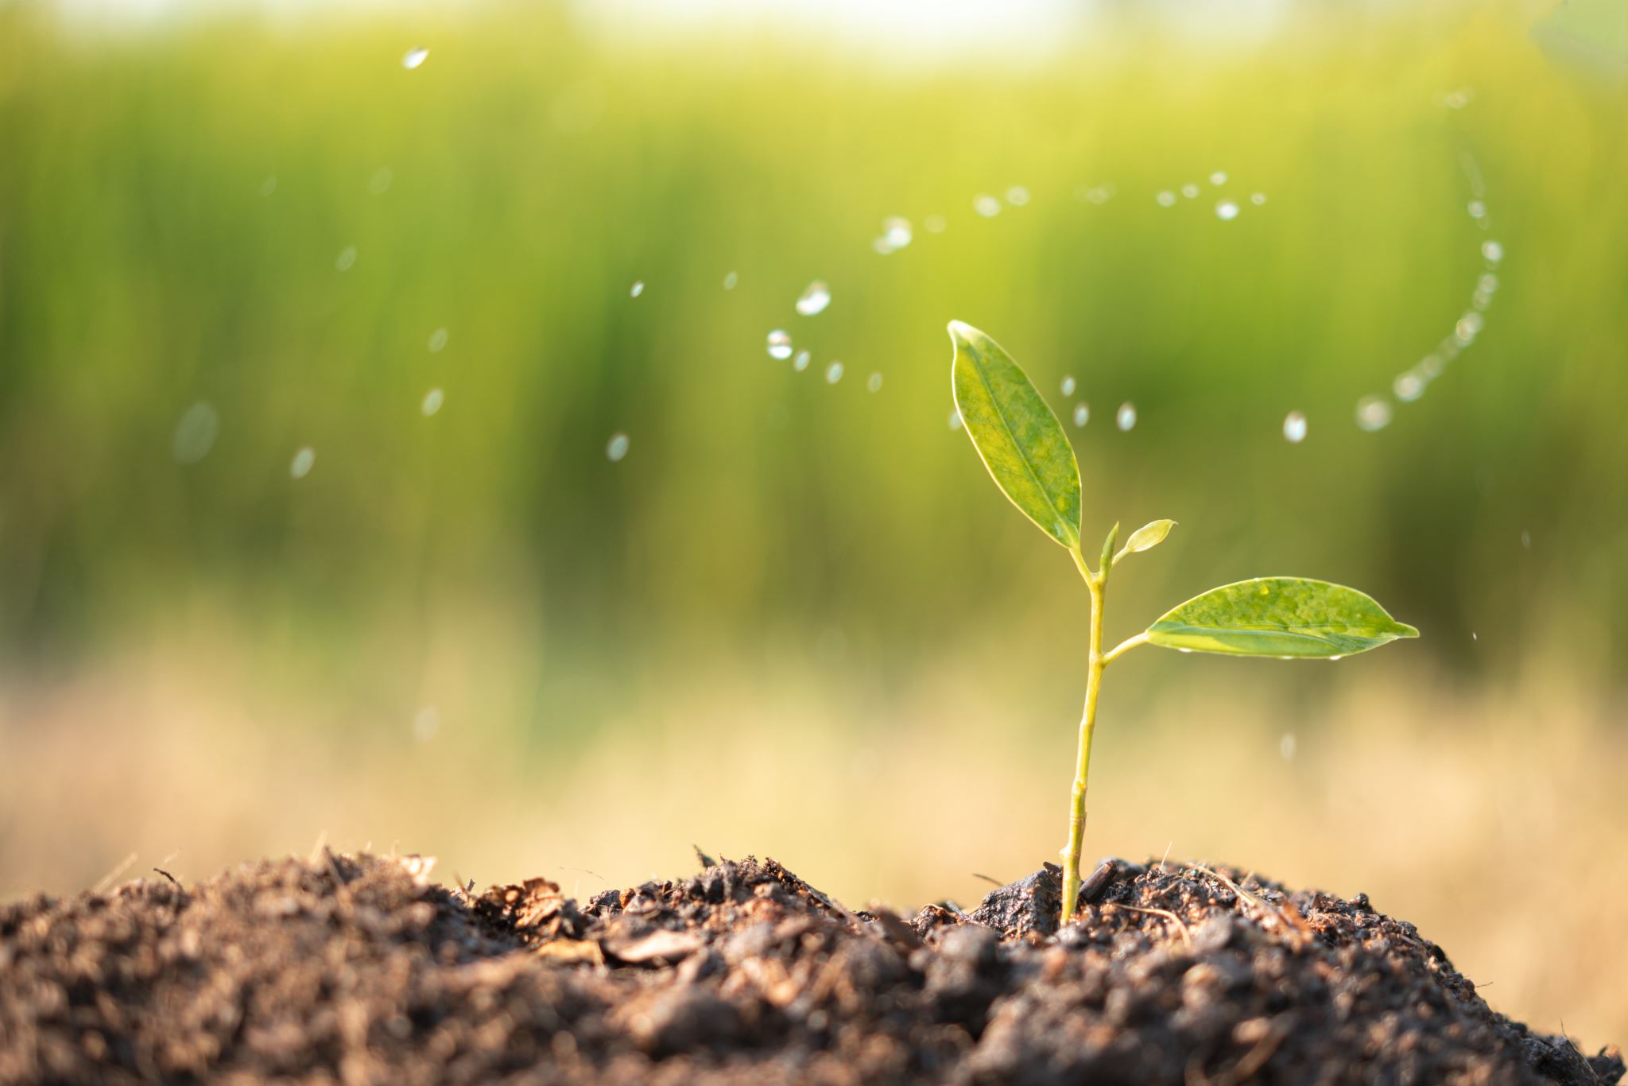
GREETINGS
commUNIty
Thank you for the opportunity to introduce myself and our purpose-driven work at
Harvesting Humanity, LLC
presented by Eboné M. Lockett
WFAE Climate Summit
04.18.2024
Notes:
Individuals/Residents: (Everyone has assets and gifts)
Associations/Clubs/Volunteers: Small informal groups
Institutions/Agencies/Businesses, etc: Paid groups of structurally organized people that are generally professionals.
Place-Based: Land, buildings, heritage,
Connections: exchange between people sharing their gifts and assets (those who find and create those connections are called connectors). “The social relationships, networks and trust form the social capital of a community.
nurturedevelopment.org
Relationships Build a Community

Slide 2
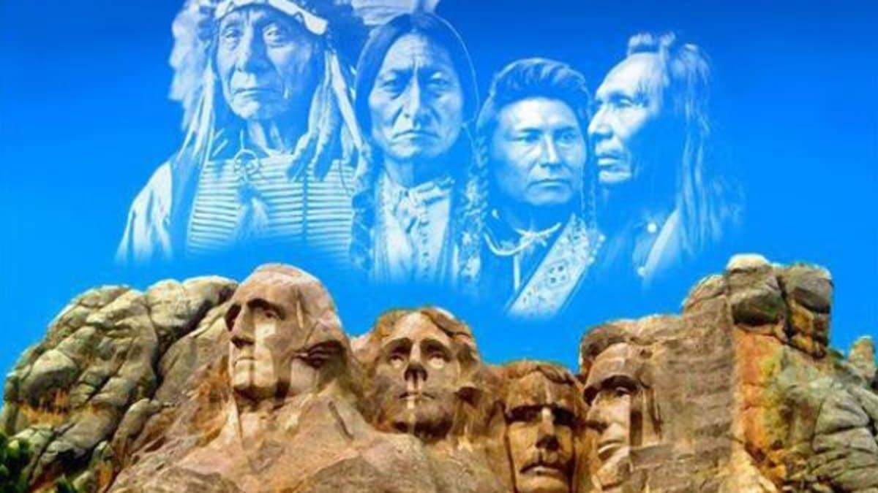
“The Forgotten Forefathers”
Acknowledgement: Here in Charlotte, NC we stand on sacred ground once occupied by the Catawba and Sugaree First Nations
Notes:
The Catawba Native Americans
In Charlotte, Is It Sugaw Creek Or Sugar Creek? | WFAE 90.7 - Charlotte's NPR News Source
Native Americans used this trail for hunting, trading, and war long before the settlers used it to migrate south. The Native Americans named the trail “Warriors Path.”
“naming the river would have been considering it property, which the Sugaree would not have done. The people who would have named the river would have been European colonists. Like how the Catawba River is named after the Catawba people who lived — and still live — near it, it seems more than likely that Sugar Creek is named for the Sugaree people.
During the mid-1700s, a lot of Native American tribes in the Carolinas had to band together for survival — many of their people were killed by diseases European colonists brought, and others died from war and battle with colonists and other tribes. So, the Sugaree and some other tribes were kind of absorbed by the Catawba.

Slide 3
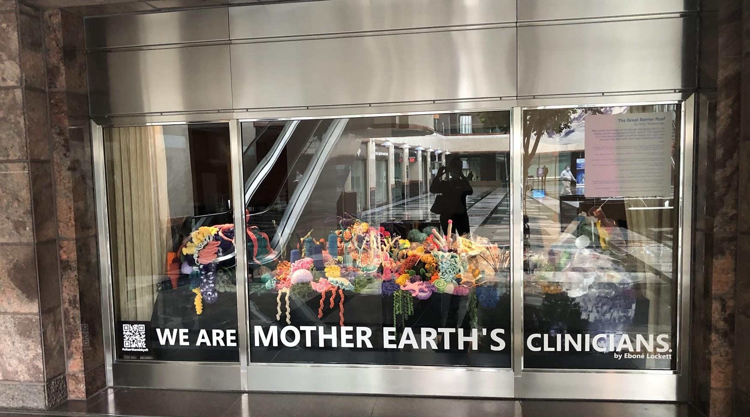
IN ‘RIGHT’ RELATIONSHIP
WITH EARTH & THE HUMAN & NON-HUMAN BEINGS THAT OCCUPY HER

Slide 4
My WHY/ (Vision)!
I AM THAT I AM
I envision a world where each person’s work in life and walk in life is in harmonious balance and alignment with Humanity and that there is an ever-present mindfulness and praxis of learning and development along that journey.
My/Our WHAT (Mission)
​Harvesting Humanity, LLC reImagines research, learning, and personal-and-professional development
"Non Scholae Sed Vitae Discimus"
"We learn not for school but for life"

Slide 5
My/Our HOW - Our Praxis
…BY innovating and executing holistically-integrated service-learning curricula and experiences that engage, prepare, and position diverse Climate, Environmental, and Social Solutionaries.
~ learning for life and lifelong learning
Being…
Teaching…
Learning…
Leading…
Experimenting…
Consulting…
Creating…
Designing…
Building…
Cultivating…
Sowing…
Solving…
Harvesting Humanity….
"Non Scholae Sed Vitae Discimus"
"We learn not for school but for life"

Slide 6
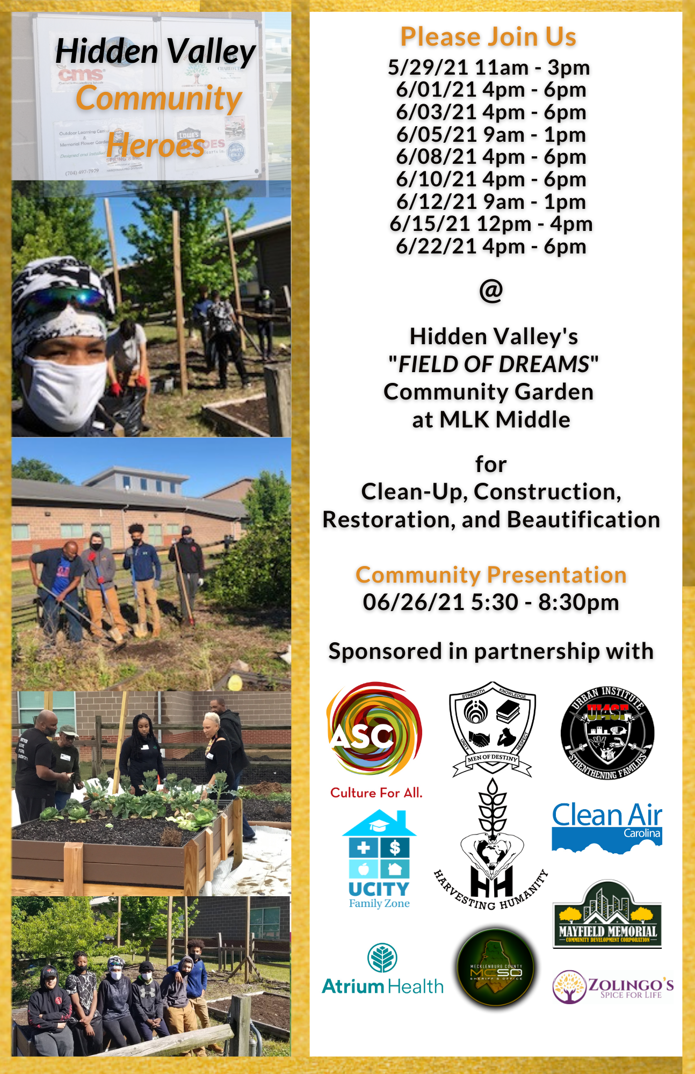
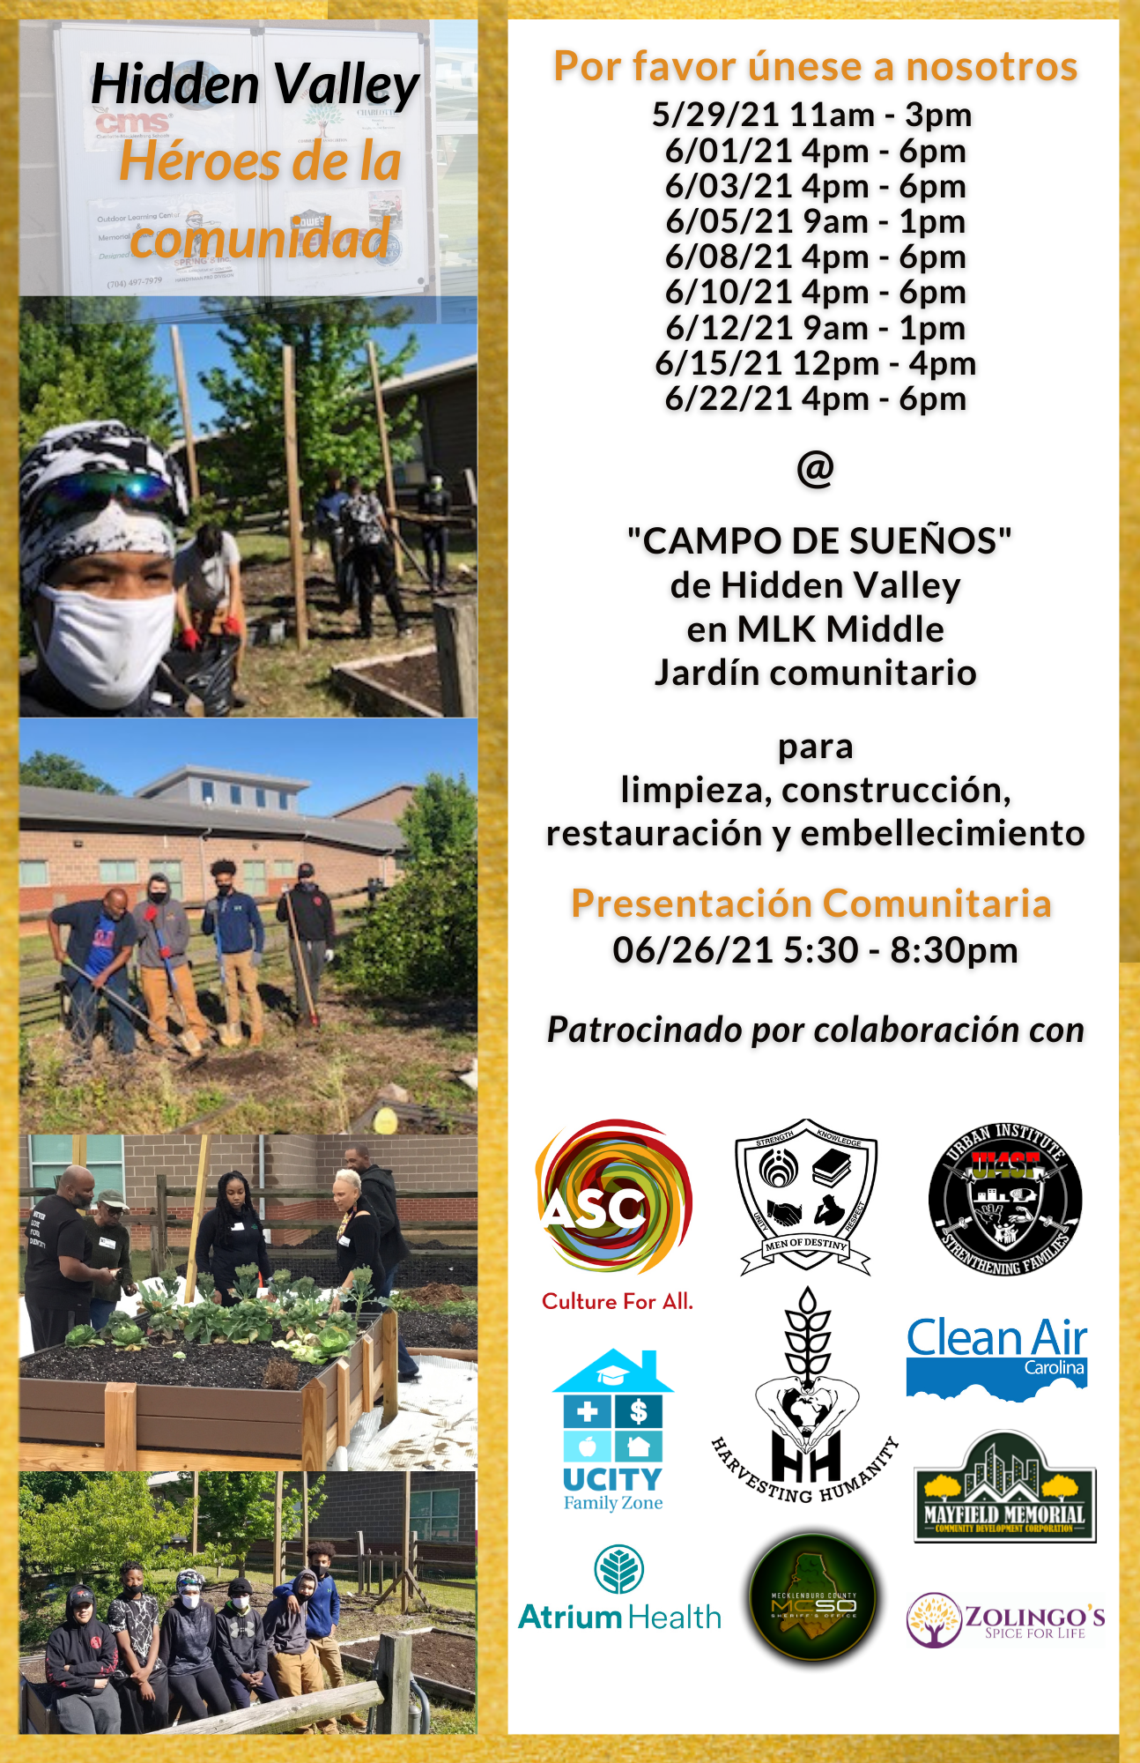

Slide 7
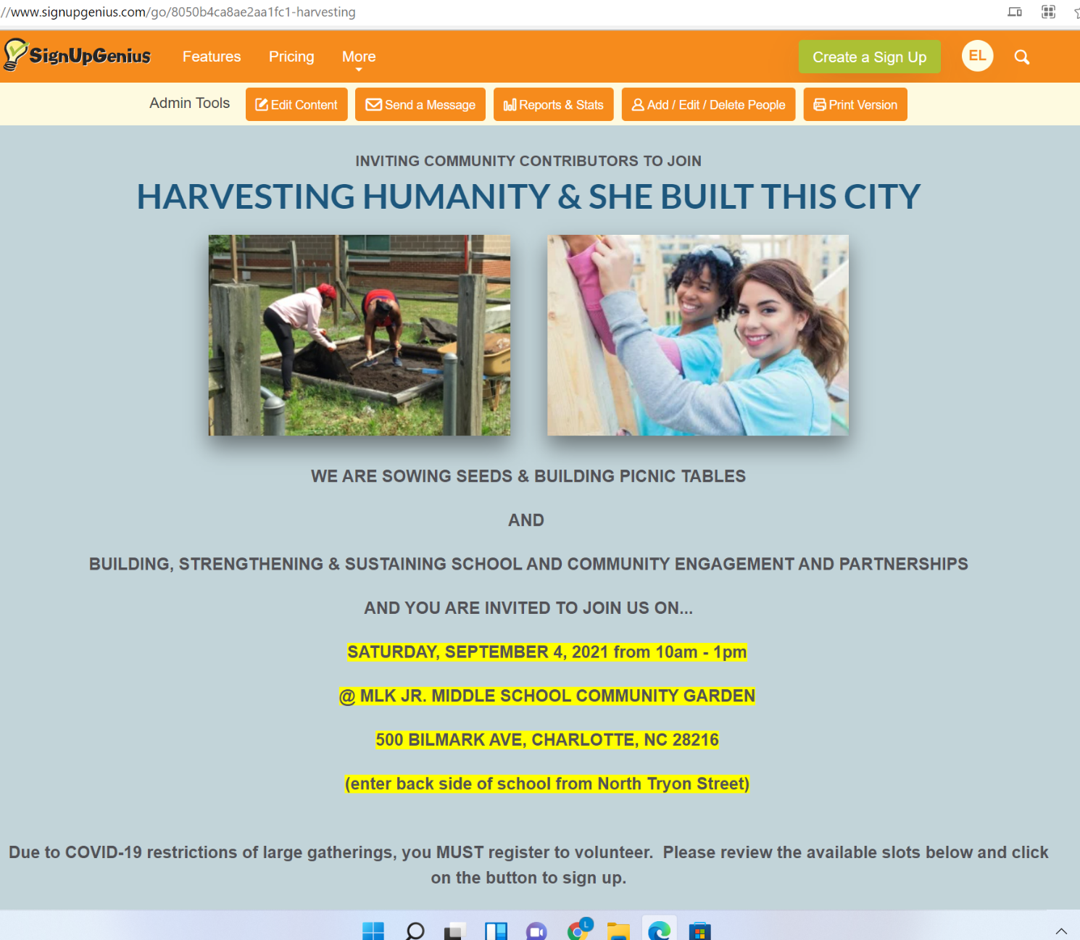
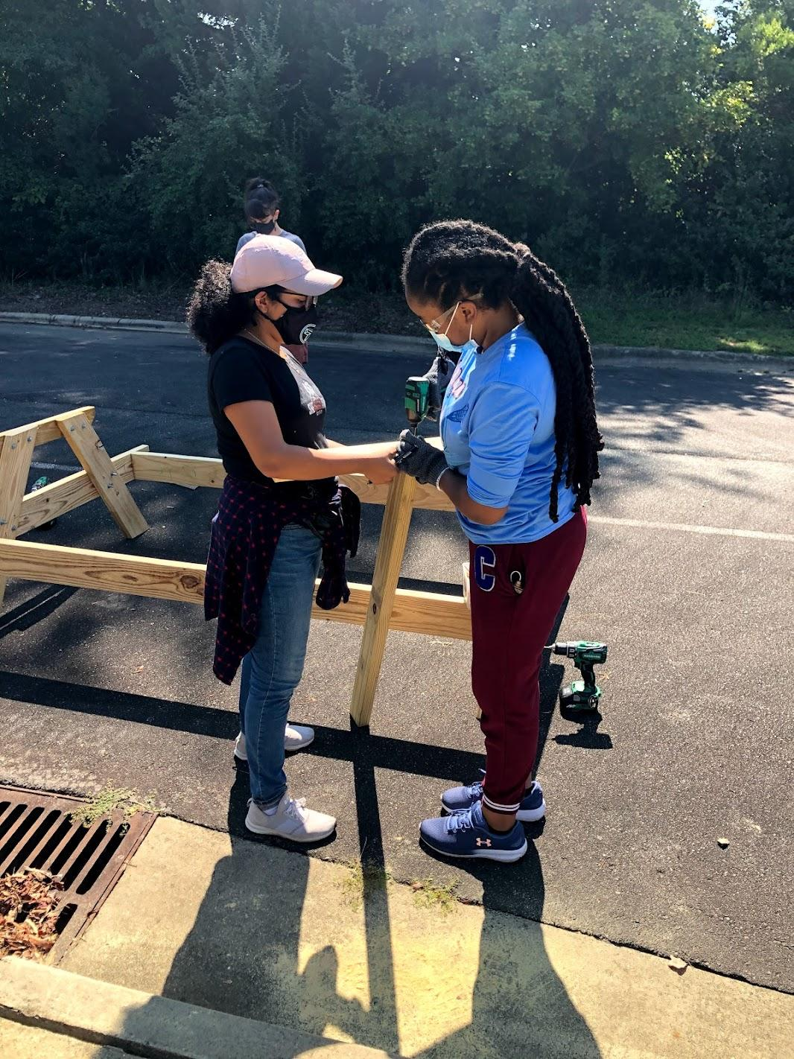

Slide 8
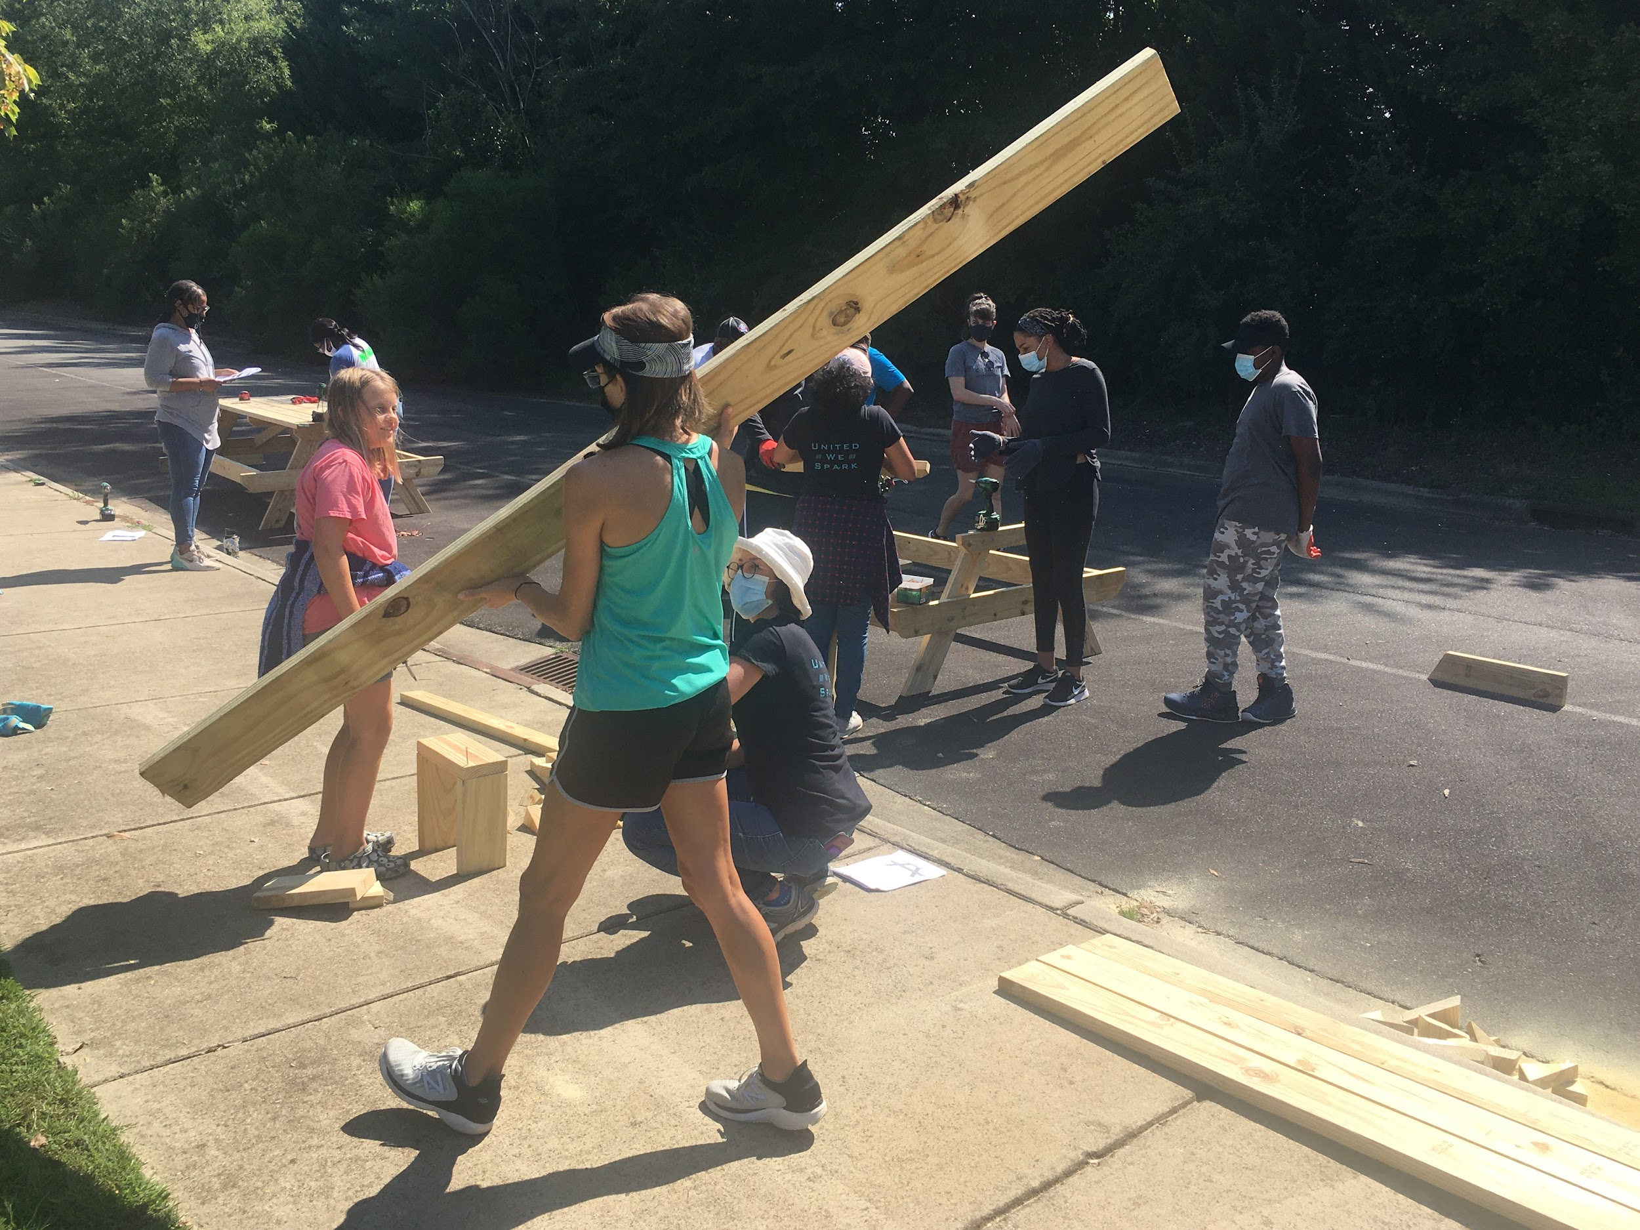
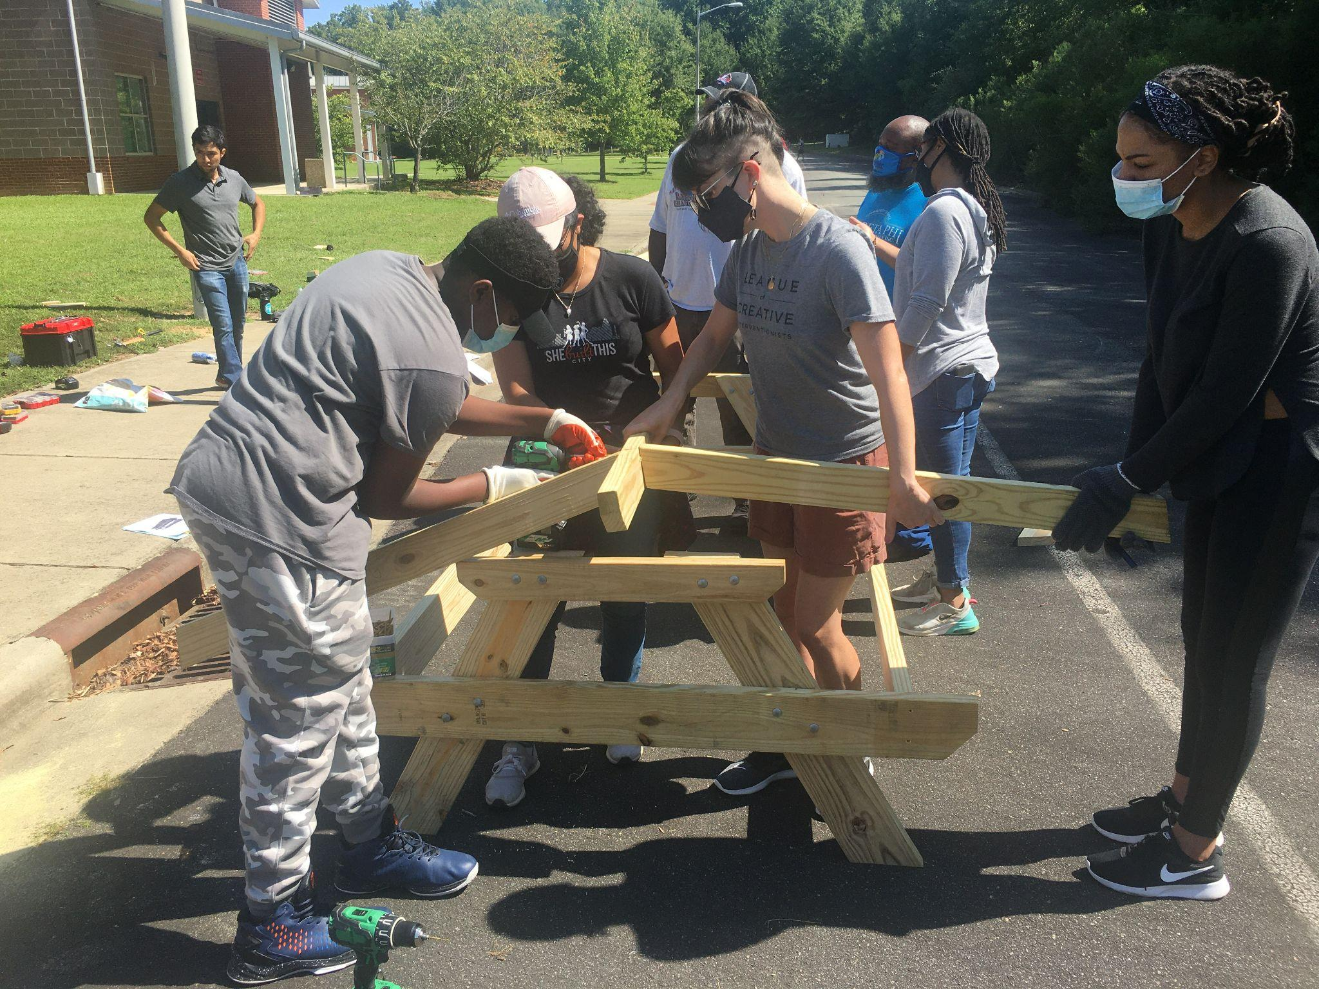
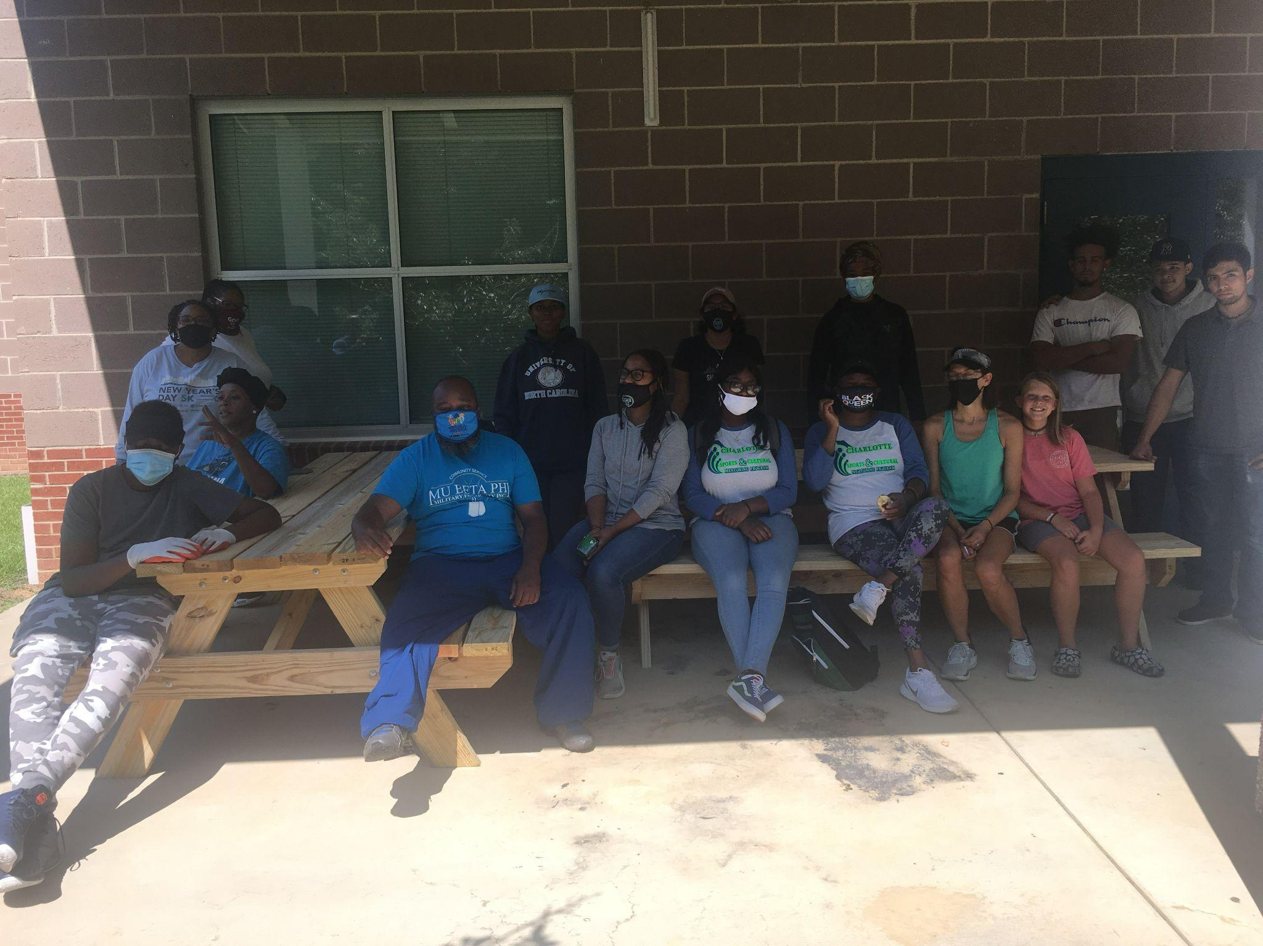
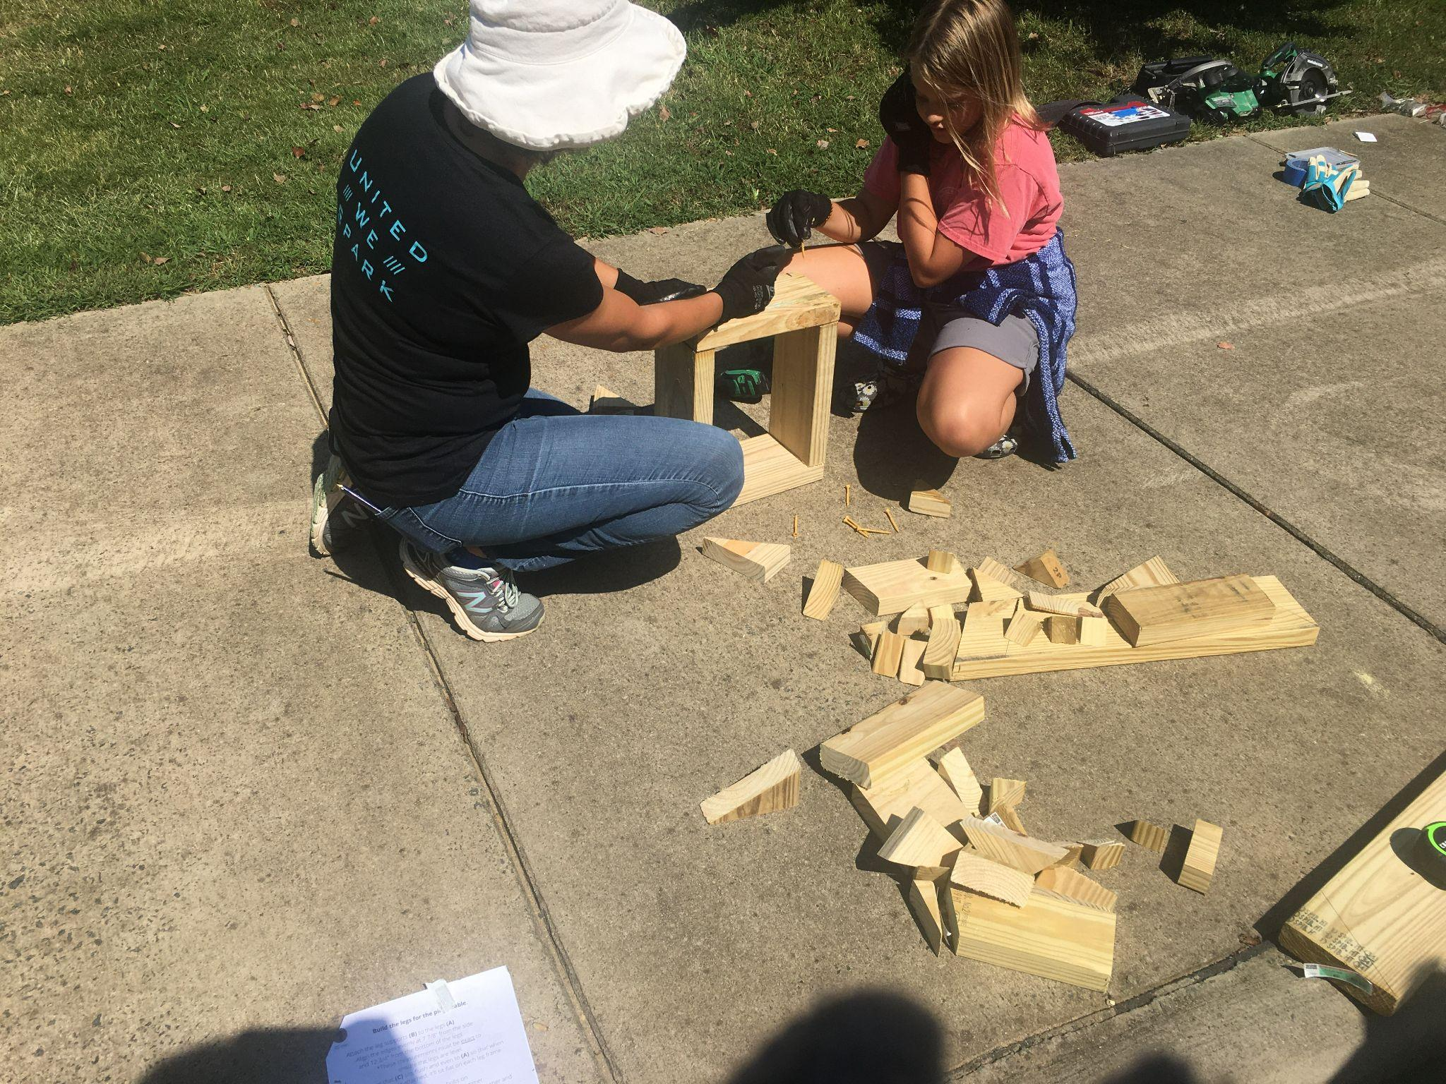
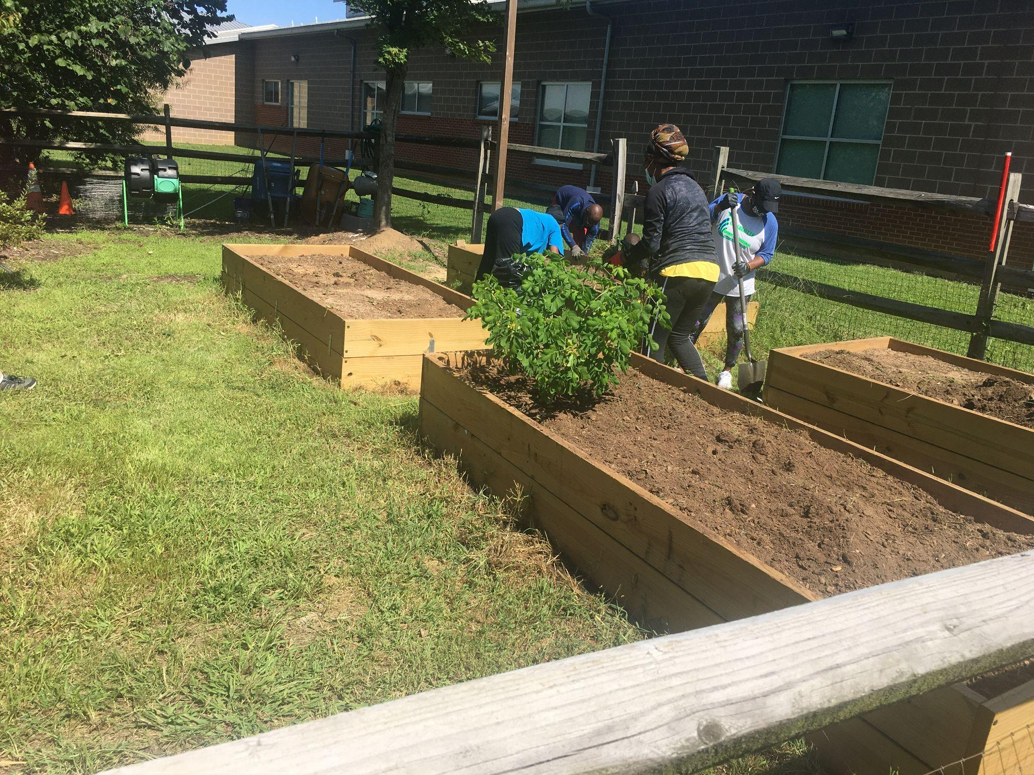
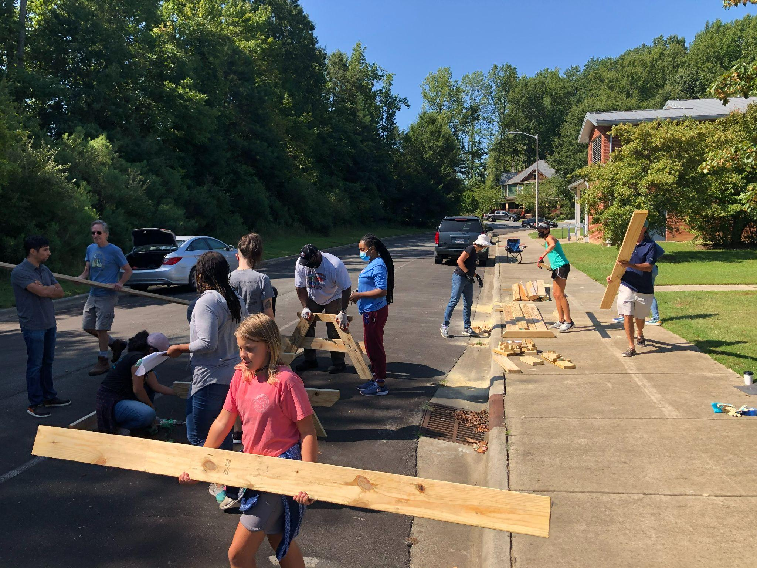

Slide 9
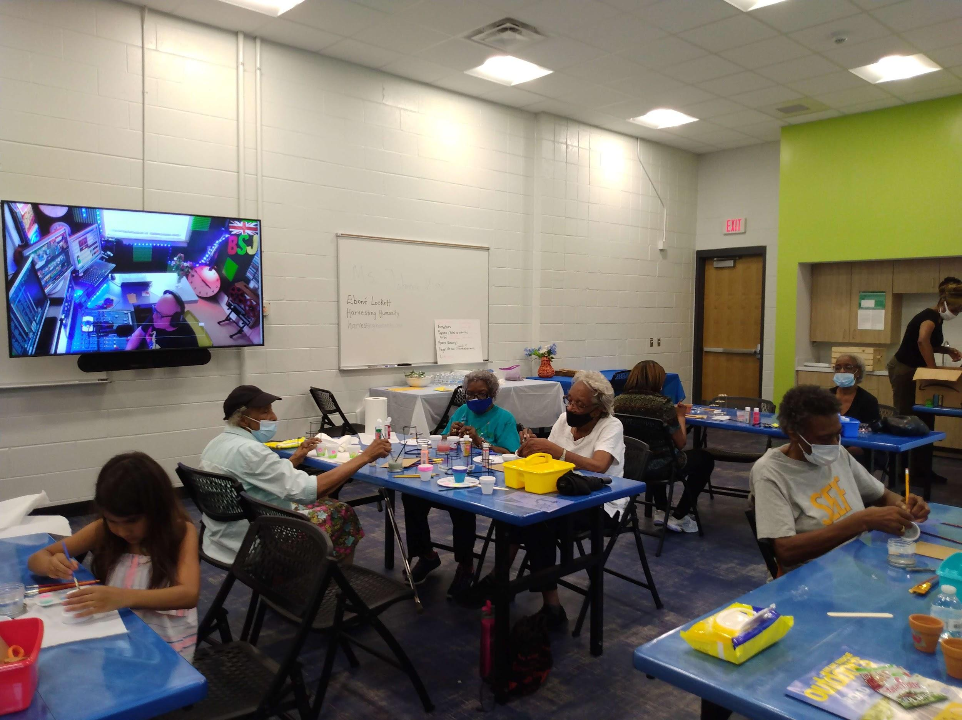
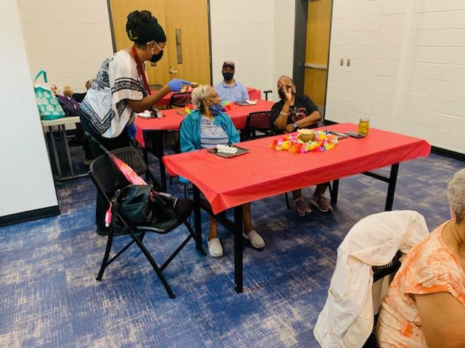
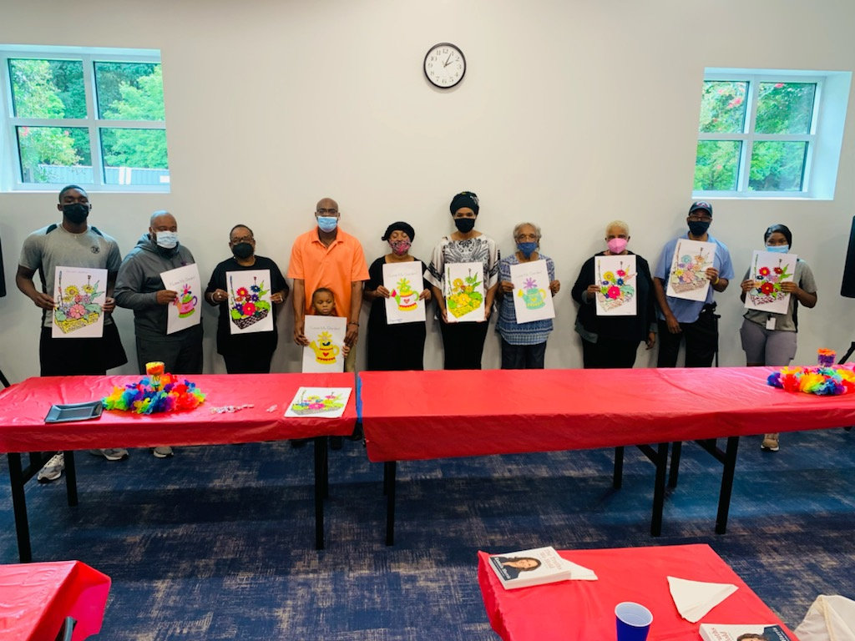
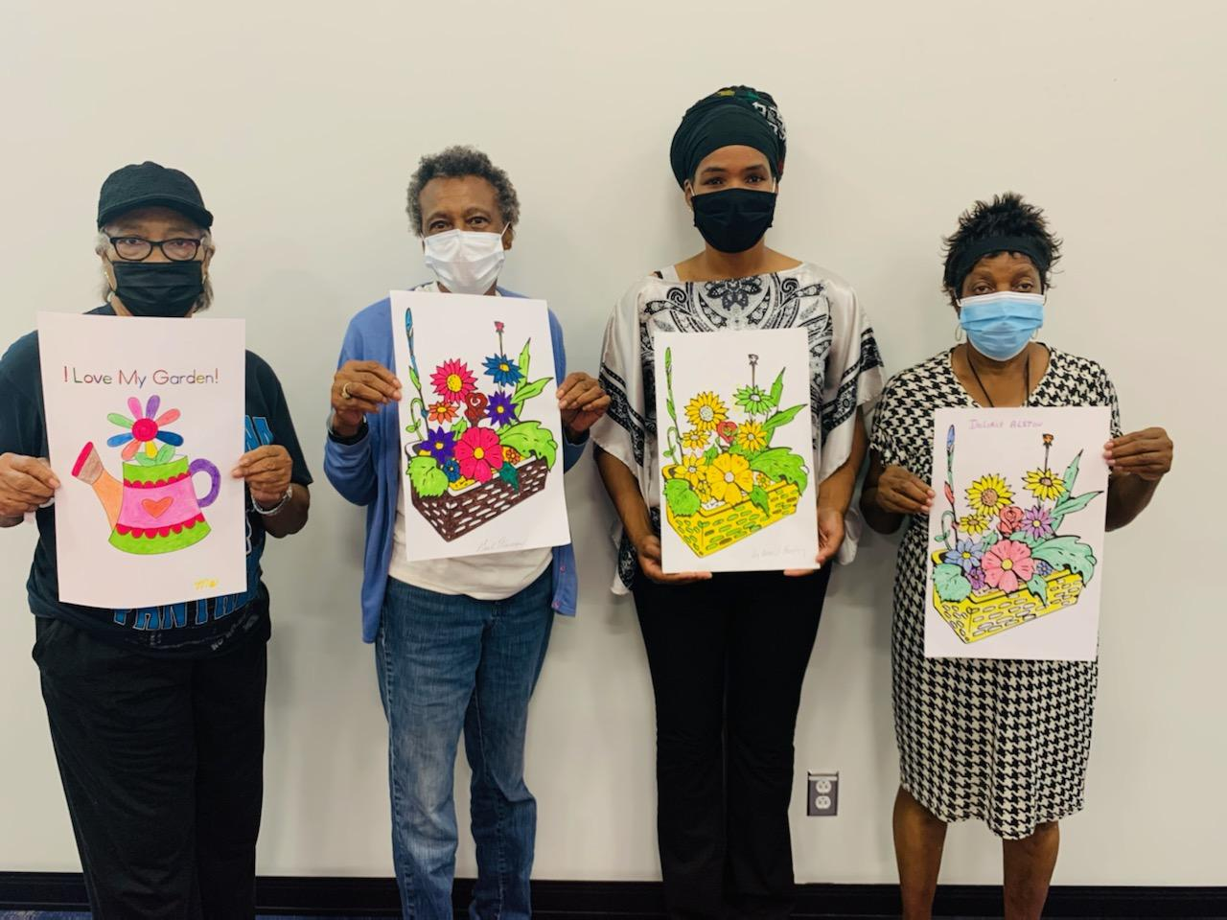
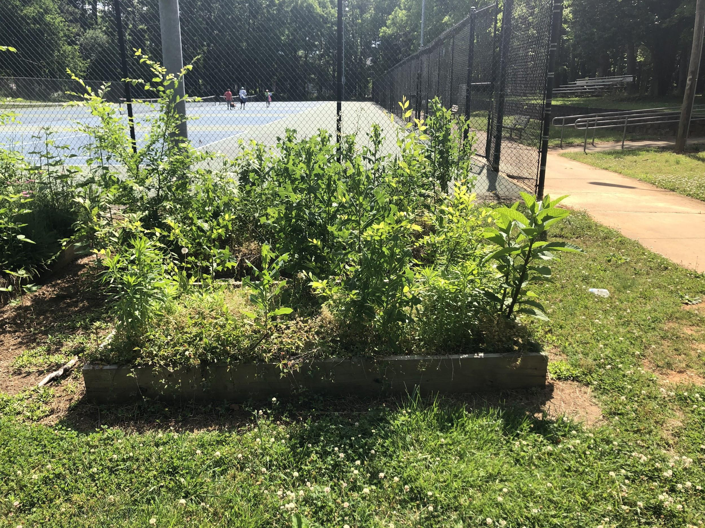
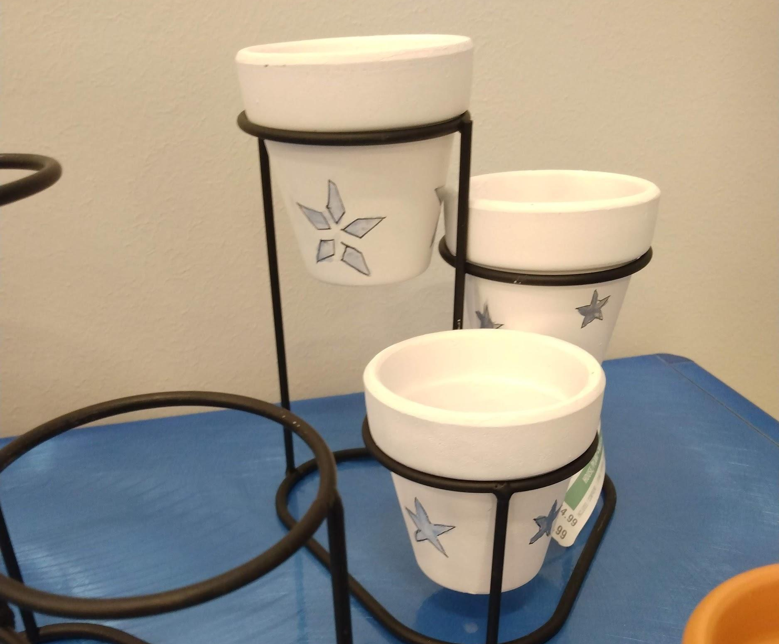
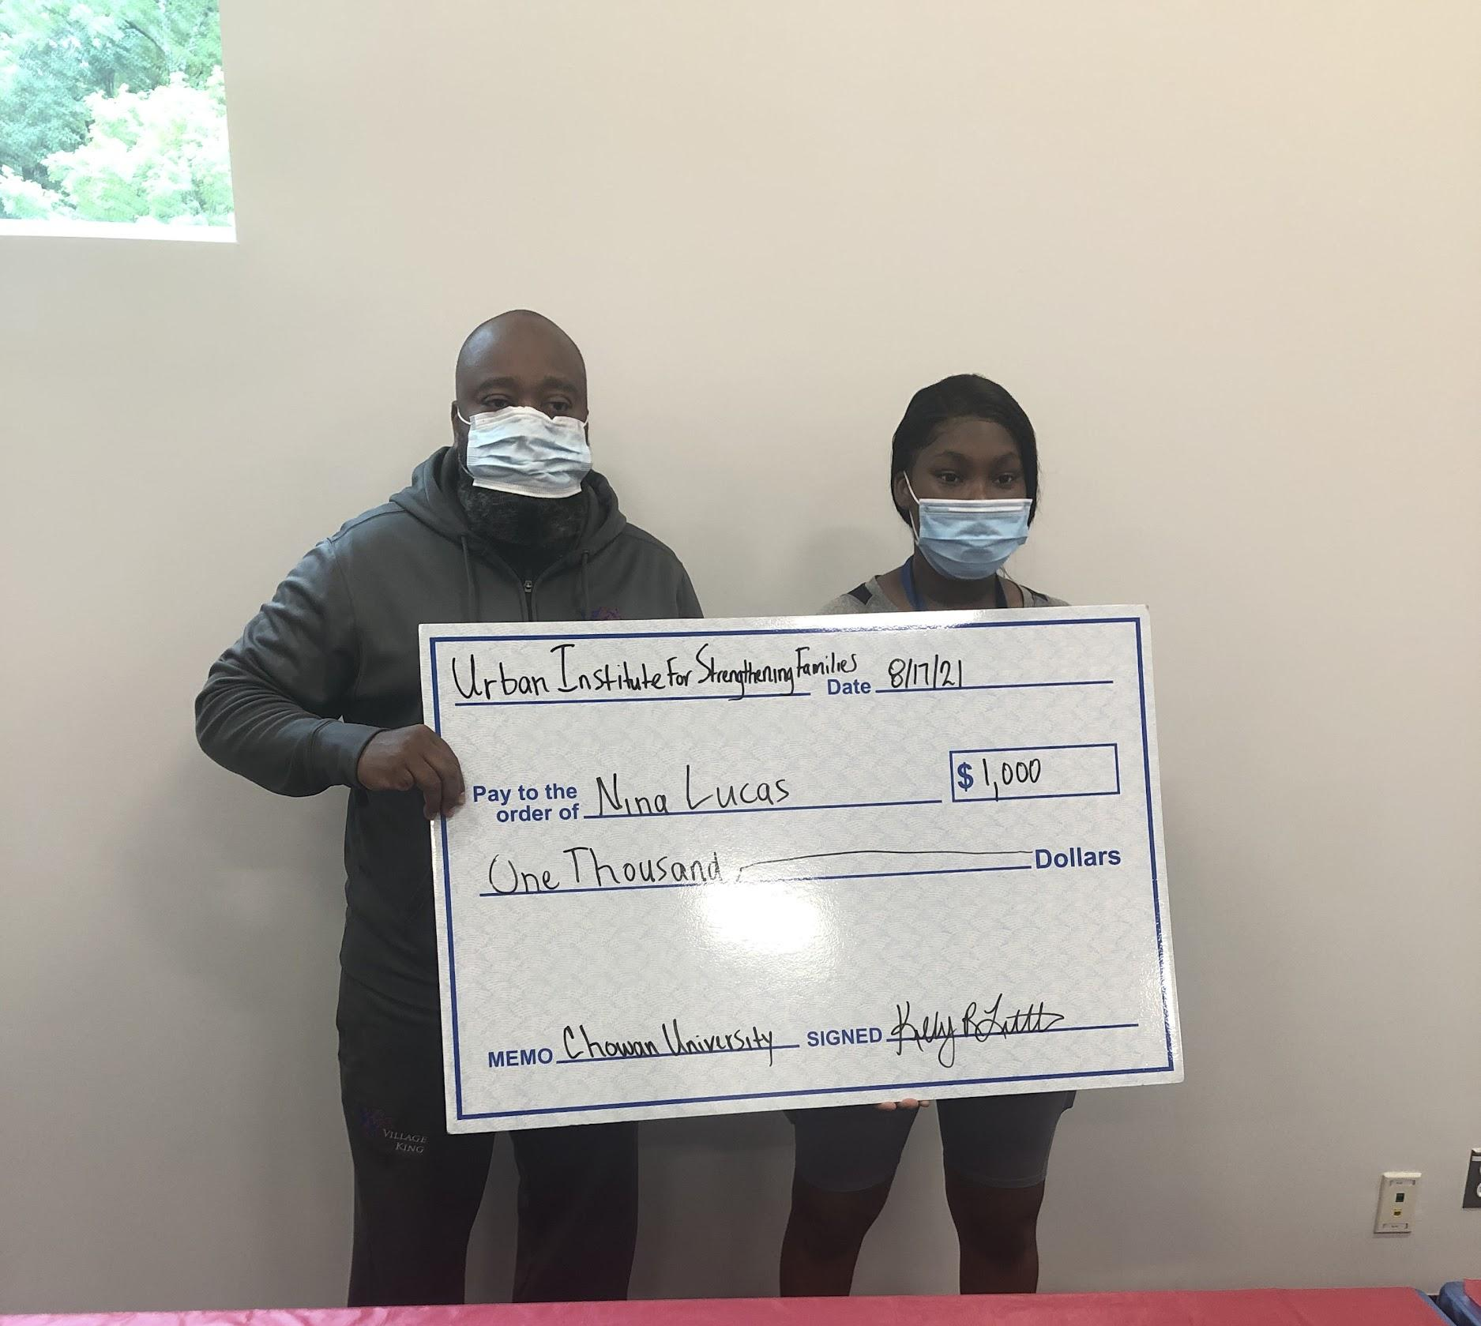
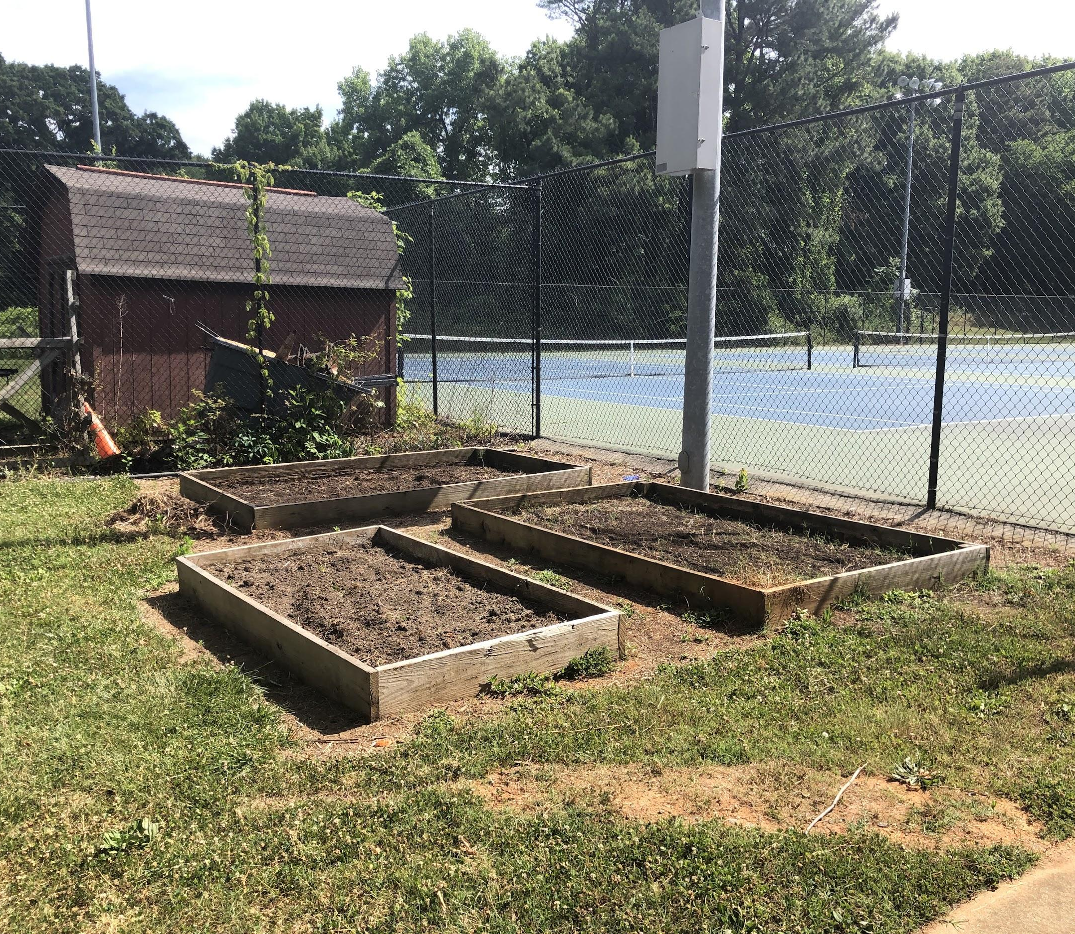
Cultivating Community

Slide 10
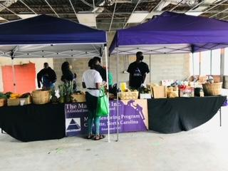
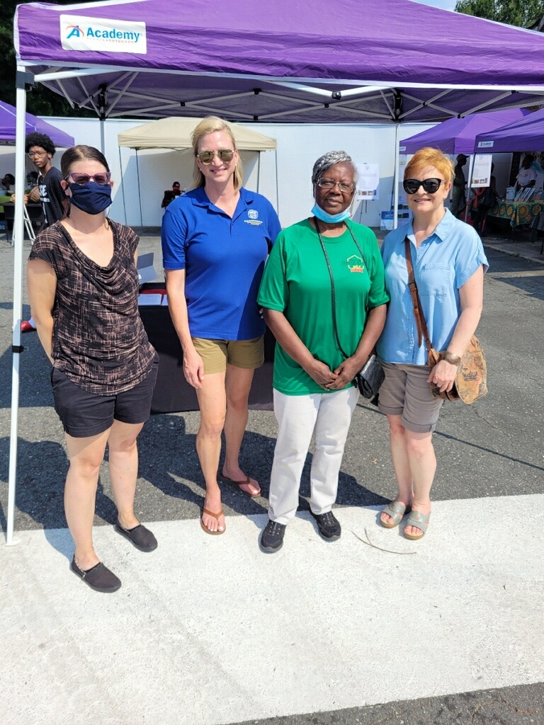

Slide 11
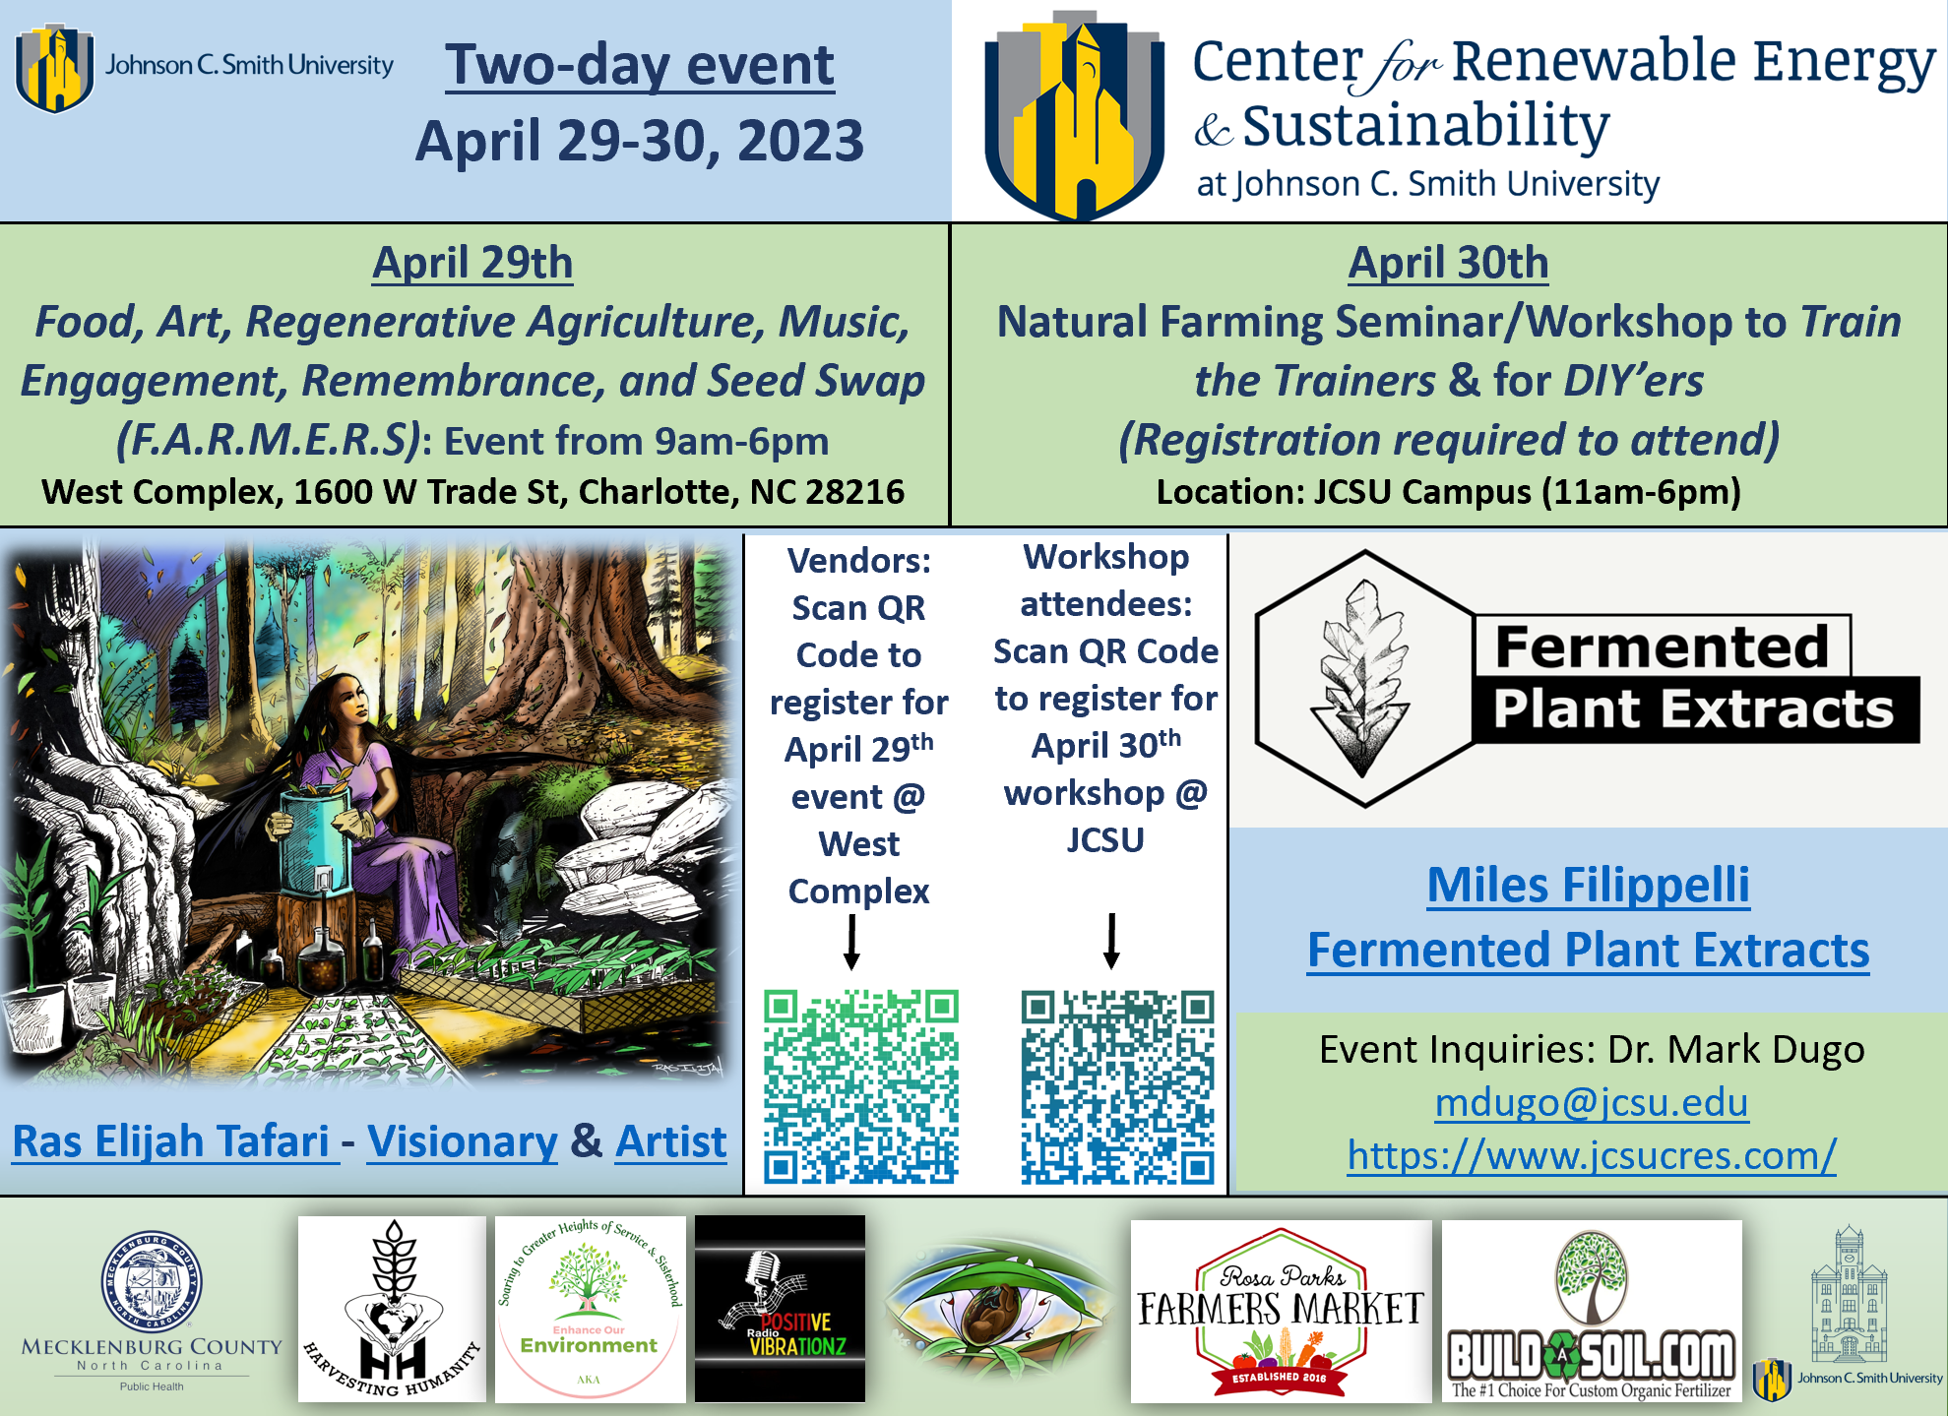
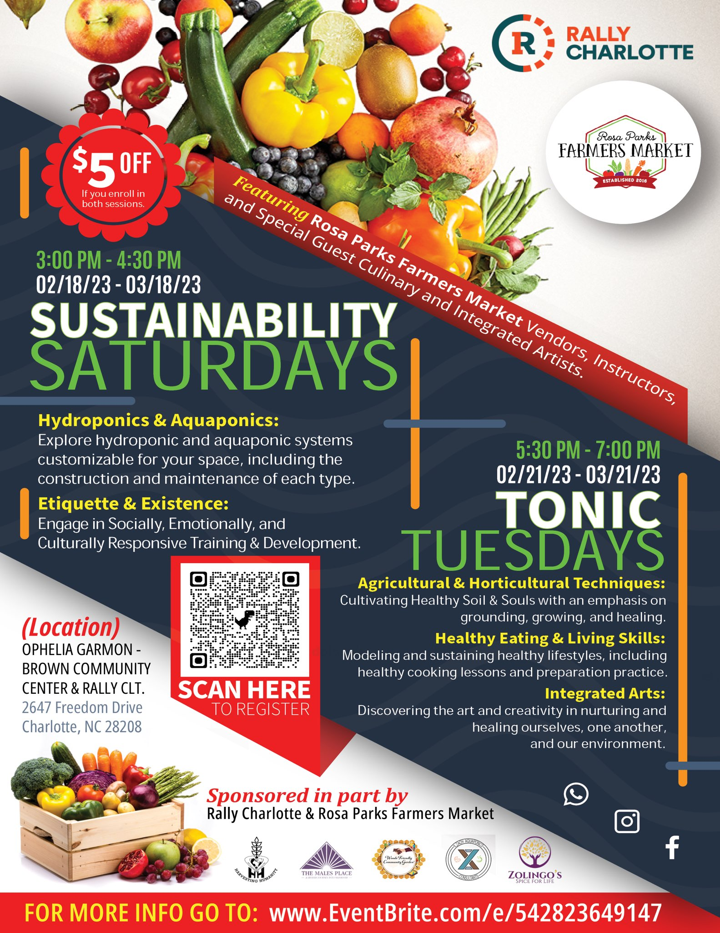
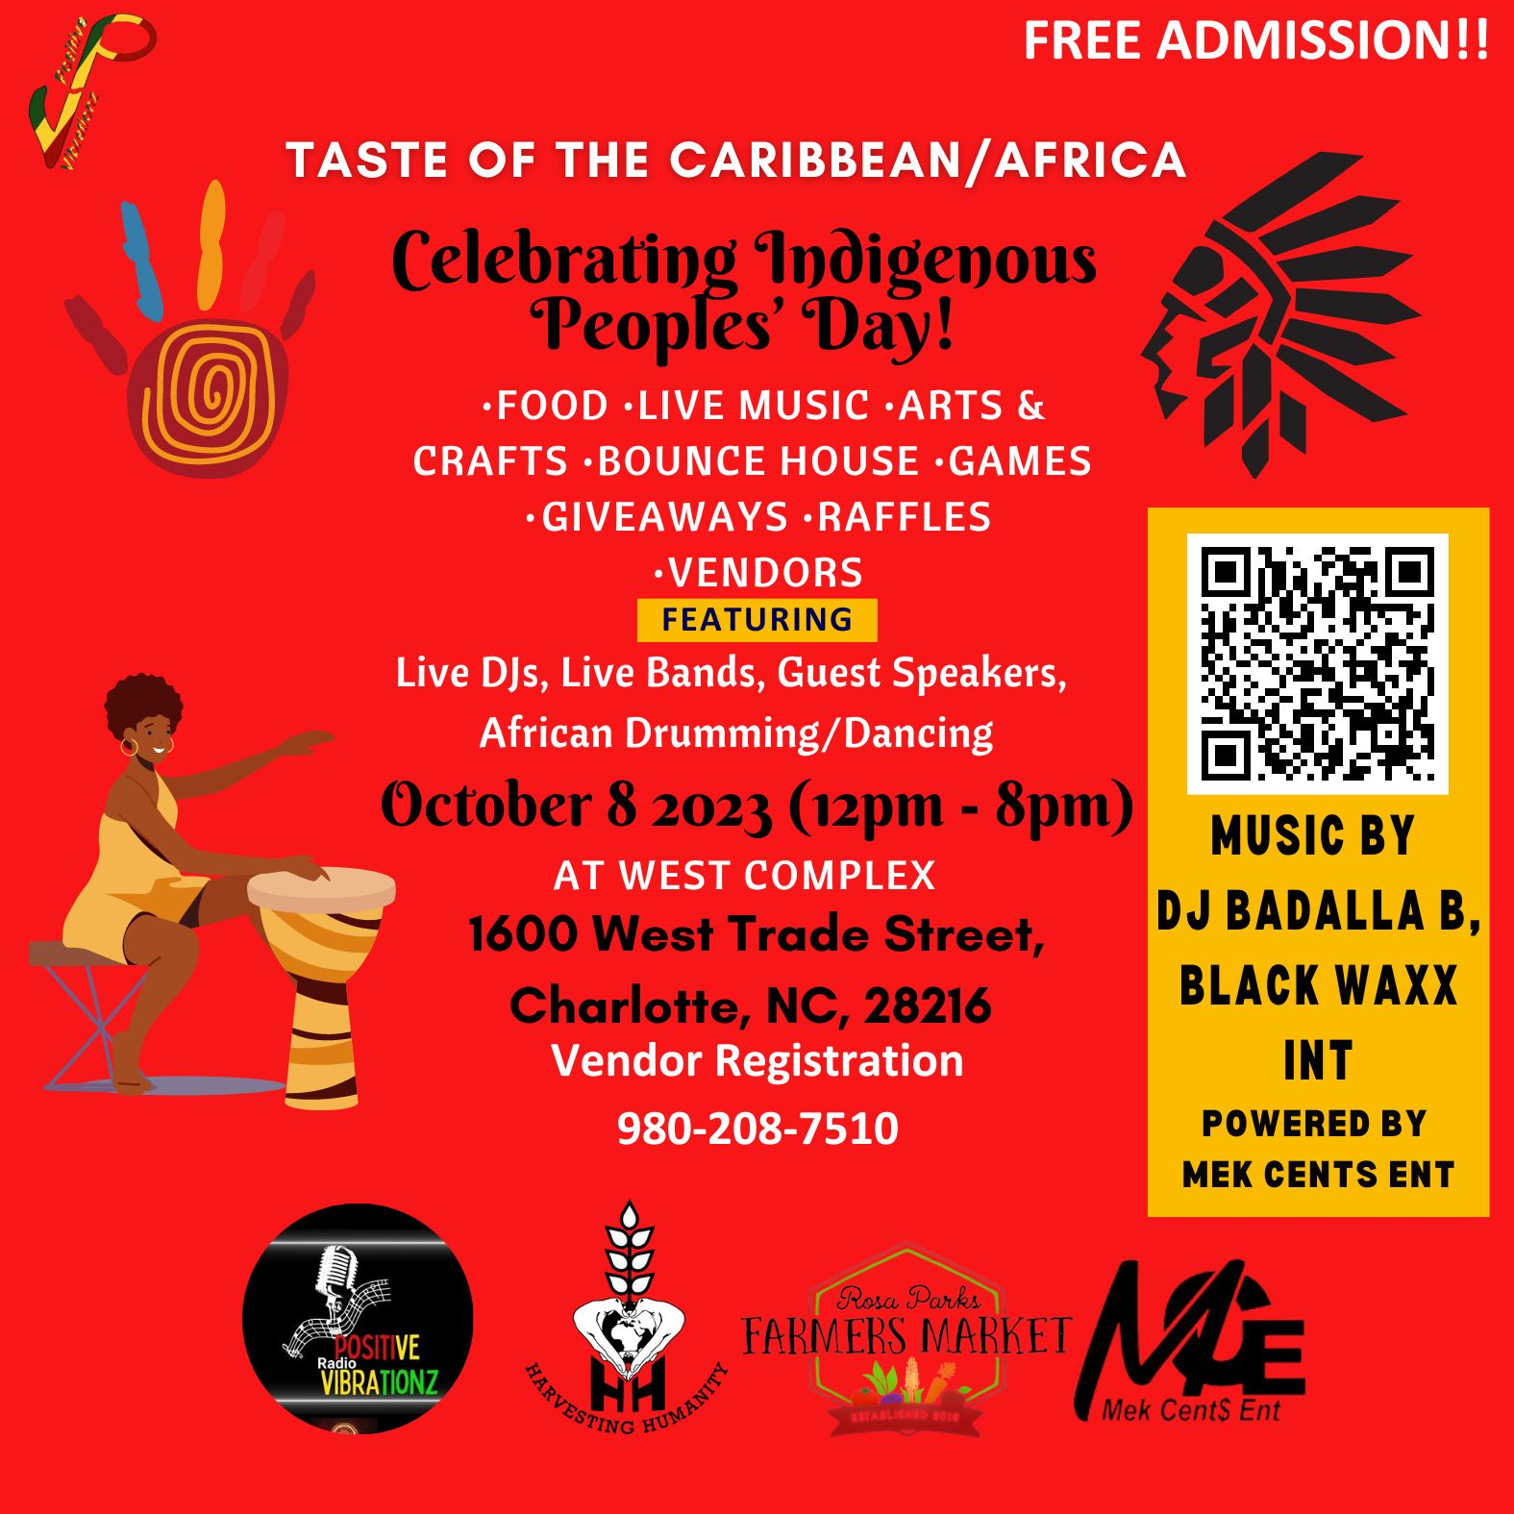

Slide 12
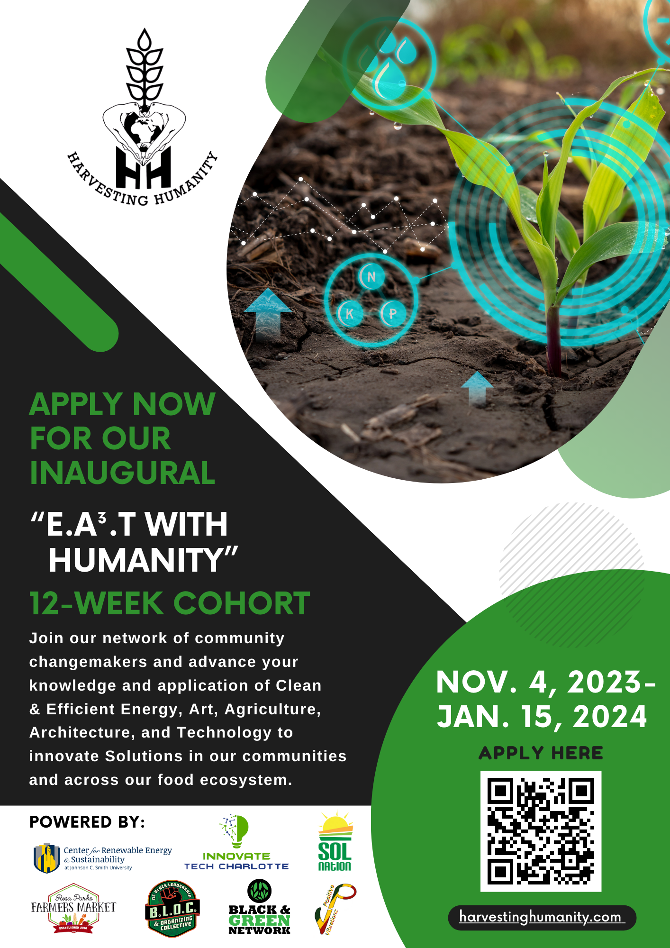
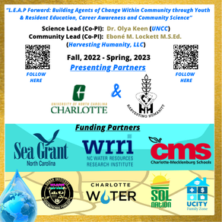

Slide 13
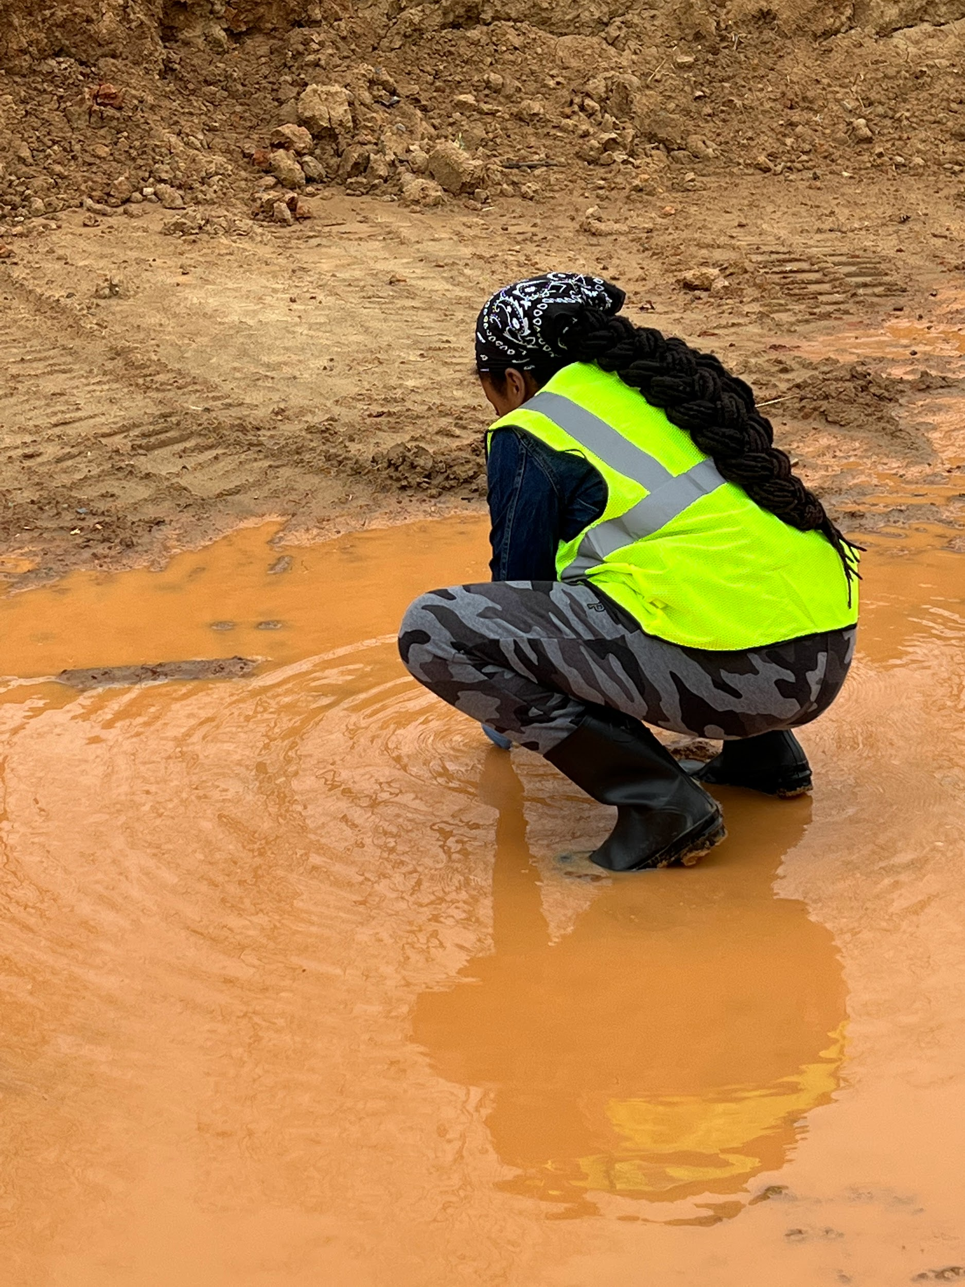
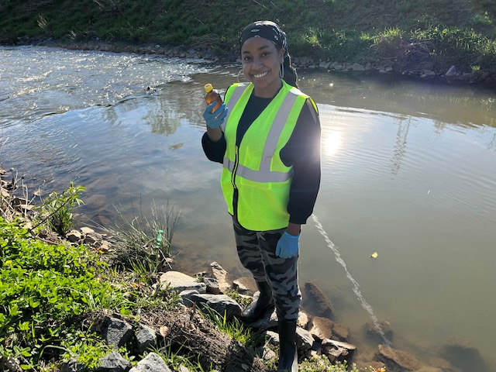
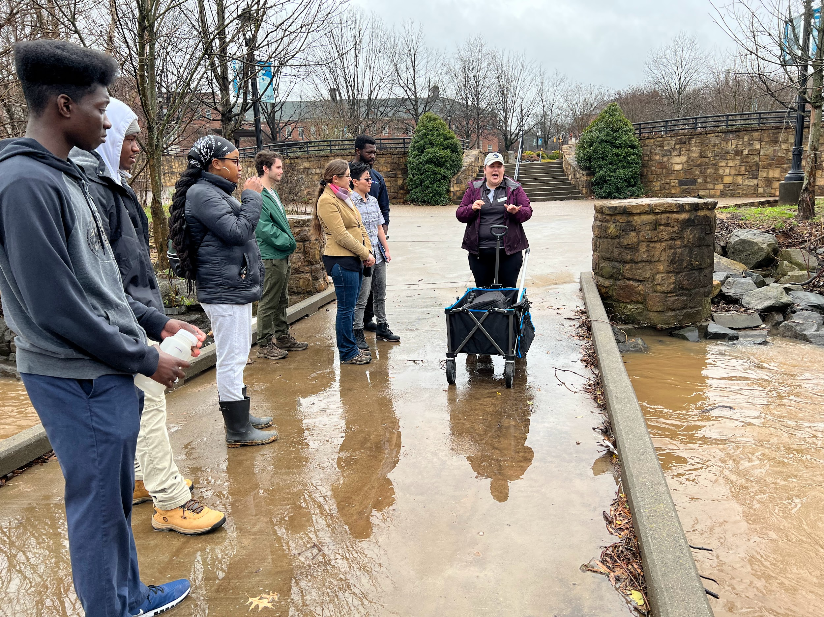
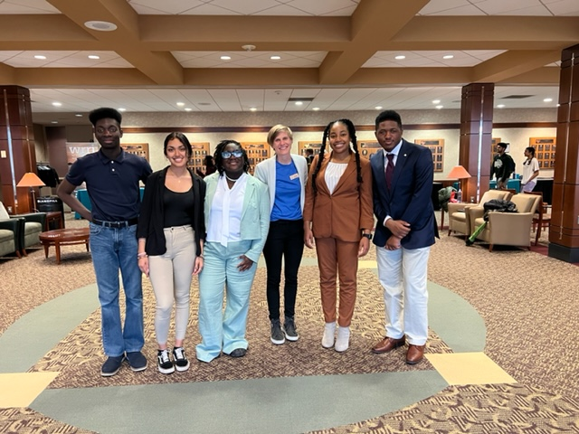
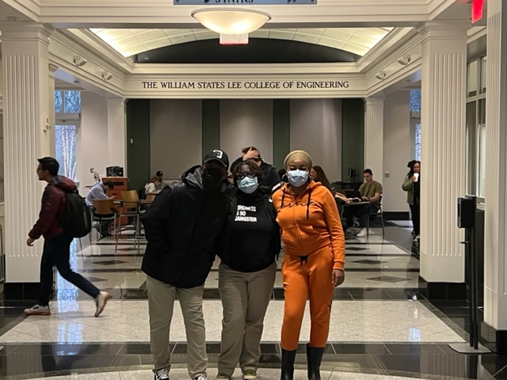

Slide 14
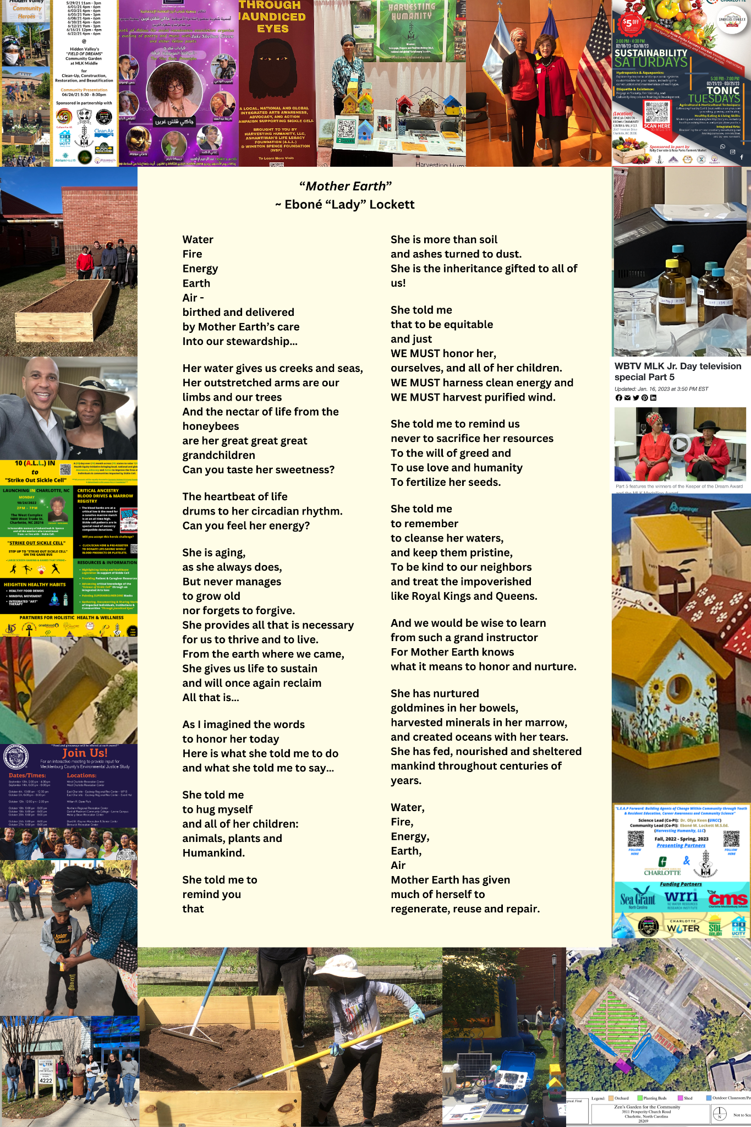
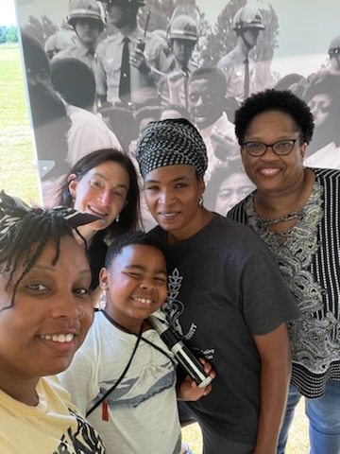
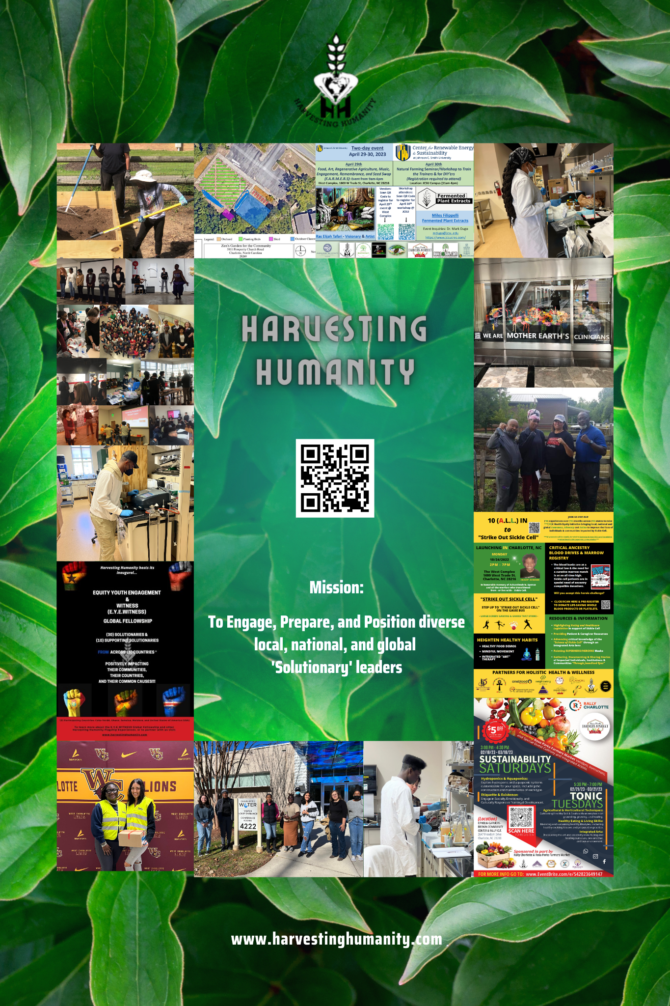
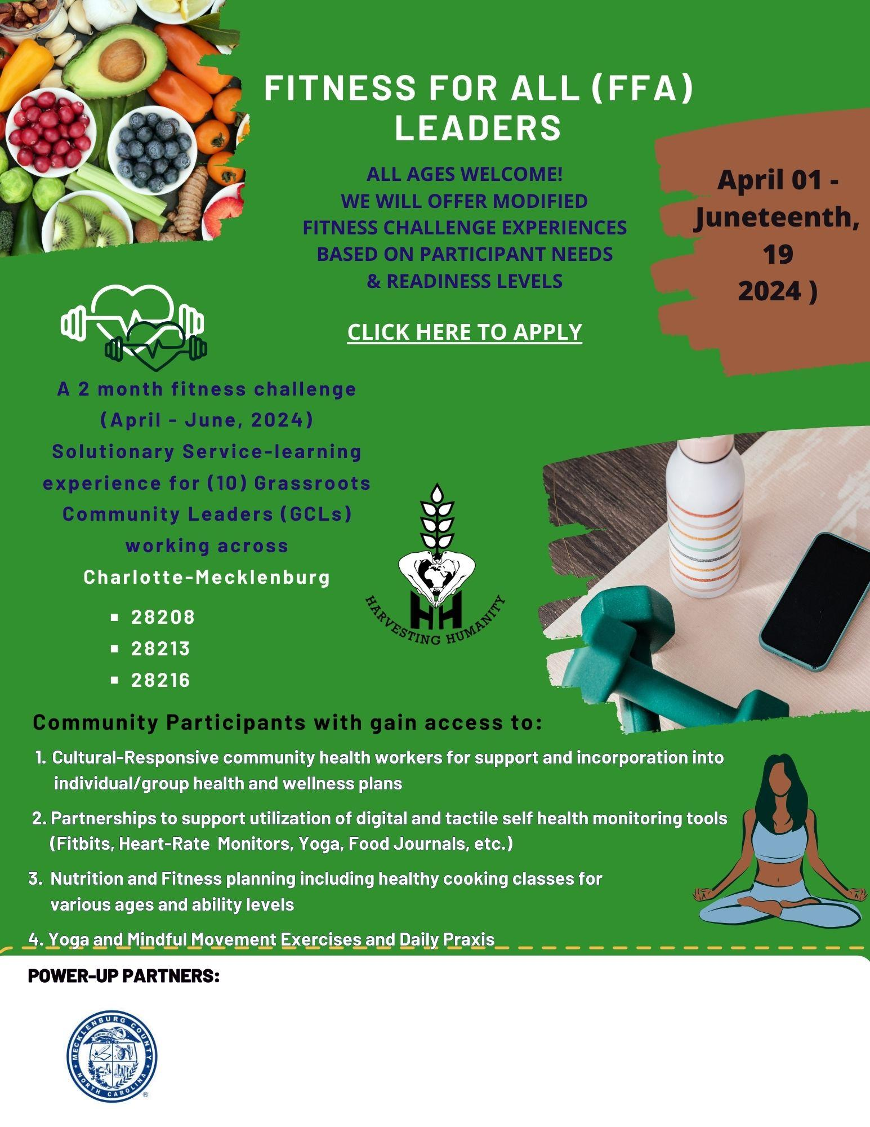

Slide 15
“~ learning for life and lifelong learning ”
Continue to donate your time, talents, technologies, and treasures to cultivating, healing, and sustaining relationships for they are the building blocks of community and the heart of Humanity and THEY will serve our communities well!!!
visit us @ harvestinghumanity.com

